Slide 1
FINAL PROJECT PROPOSAL
NFC ENABLED STUDENT CARD
Raissa Pululu – K00206715
Brendan Watson – Supervisor
09/10/2023

Slide 2
PROJECT AIM
Bridging the digital gap in educational institutions
Enhancing security
Creating an efficient, automated and convenient campus
Implementing a versatile API.

Slide 3
PROJECT OBJECTIVES
GOAL 1
GOAL 2
GOAL 3
GOAL 4
Integrate NFC technology with student IDs
Enhancing security and automating attendance tracking
Enabling cashless transactions for convience and efficency
Developing a robust API for scalability and adaptability

Slide 4

NFC TECHNOLOGY INTEGRATION
Support Read/Write, Peer-to-Peer and Card Emulation
Incorporates encryption and secure communication protocols
Intuitive user interaction, ensuring accessibility and ease of us

Slide 5

DOOR ACCESS CONTROL
Tailor access permissions according to roles and responsilibites
Real-Time admin monitoring system to track all data
Secure campus with controlled access reducing congestion

Slide 6

ENHANCED ATTENDANCE TRACKING
Attendance is automatically recorded using an RFID reader in a classroom
Real-time attendance sent to educator during set time frame of a class
Accurate attendance while saving time

Slide 7

PAID PARKING CANTEEN TRANSACTIONS
Contactless and cashless payments for parking and canteen services
Real-time transactions reducing wait times
Top-up and track transactions and balance through portal

Slide 8
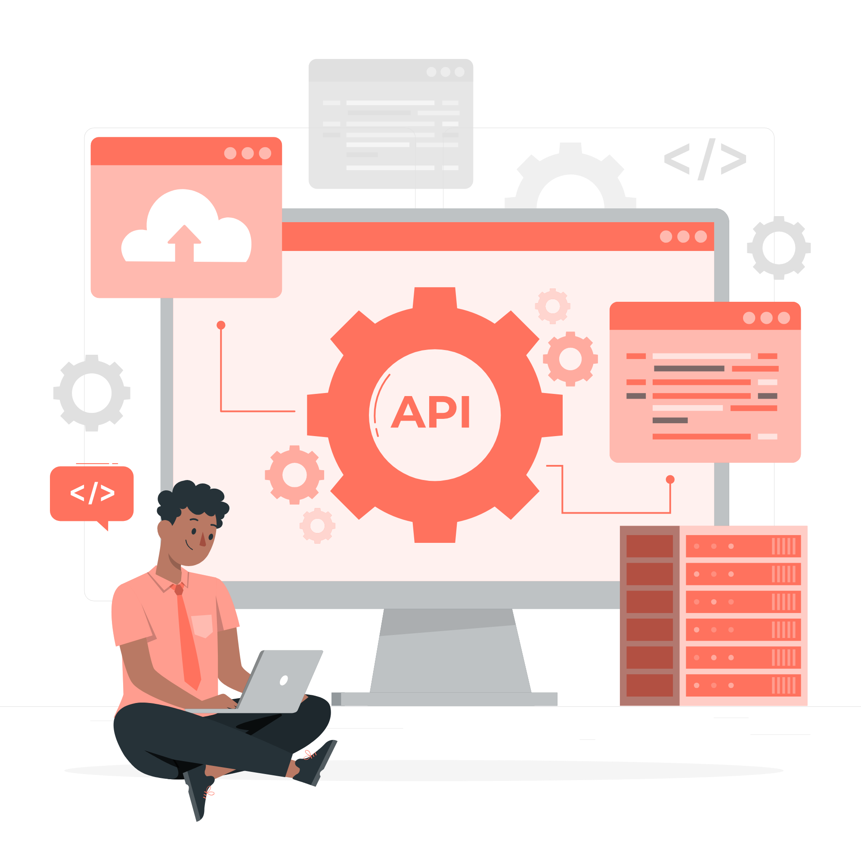
UNIVERSAL API INTEGRATION
Ensuring seamless integration with existing functionality
Handle increased data and user interactions as campus population grows
Promote flexibility with adaptable hardware integration and organizational structures

Slide 9
IMPLEMENTATION PLAN
HARDWARE
Software
Real-Time Admin Dashboard
Student Dashboard
Secure and Encrypted Data
Universal API Integration
Rasberry Pi 4
LCD Module
Solenoid Lock
5v Relay
Programmable RFID Reader/Writer

Slide 10

SECURITY AND COMPLIANCE
AES and hashing algorithms to encrypt sensitive data
Strict access control based on roles and responsibility
Ensure hardware meet international standards
Regularly patch API to manage vulnerabilities

Slide 11
THANK
YOU!!!!!
Do you have any questions?

